Slide 1

Fire Simulation and Modelling for Data Centers
Submission 6 – Group Presentation Paper Draft 2
Group 2
Course | Petri Net Theory And Modeling Of Systems (CSE718)
Faculty | Annajiat Alim Rasel [AAR]
Name | ID
Sushana Islam Mim | 22273001
Mirza Ahmad Shayer | 22273008
Salman Sadat Nur | 22273011
Nazia Parvin | 23166034

Slide 2
Abstract – Data is the modern day important currency that the world runs on. It is crucial that this data is safely stored and not lost. Servers come to mind when large data storage is required. Many servers are needed, so server racks are grouped together in buildings - called data centers. Anytime any disaster can strike. Fires often break out of data centers which are difficult to control. All data in the racks are destroyed. fire modelling in data centers are essential to stop fires from destroying servers. A background study is conducted in chapter 2. Details on data center fire detection is discussed in 3, followed by fire suppression systems in 4. Chapter 5 shows a ML-based approach to fire detection-suppression with all details and model simulation is shown in 6. Lastly, conclusion then future research.

Slide 3
Introduction
In the rapidly evolving landscape of our digital era, data has emerged as the cornerstone of our technological progress, functioning as the most valuable currency. The intricate web of our global society relies heavily on various forms of data, making its secure storage and preservation a paramount concern. Data centers are the nerve center of any organization or country.
The requirement for enormous data storage and processing capacity is driving the skyrocketing demand for data centers as technologies like artificial intelligence (AI), the internet of things (IoT), and cloud computing become more popular with consumers and companies.

Slide 4
Introduction (Continued)
While these centers are designed to be secure, the specter of unforeseen disasters, particularly fires, looms ominously. Protecting the vital data and computer resources kept in data centers requires effective fire protection. Servers may sustain irreversible damage from fire, which could result in disastrous data losses involving banking transactions, medical records, intellectual property, etc.
In light of this, mapping and understanding the statistical information on fires- like their types, number of incidences per year, and confirmed fatalities- is crucial. In the pursuit of fortifying data centers against the looming threat of fires, this endeavor aims to refine and expand upon a graph-based approach.

Slide 5
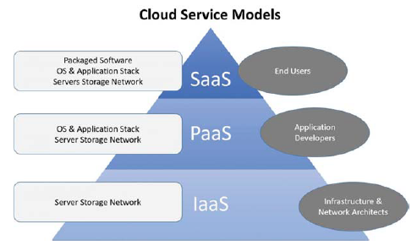
Background
In the data center, there are often racks of servers. The servers contain all data - which is considered the cloud. According to Ahmed, Khadhim and Kadhim, ownership of cloud infrastructures are shared over the internet. Additionally, services provided by the cloud is superior, reliable and easy to utilize. Three models of cloud computing are very common - Infrastructure as a Service (IaaS), Platform as a Service (PaaS) and Software as a Service (SaaS).

Slide 6
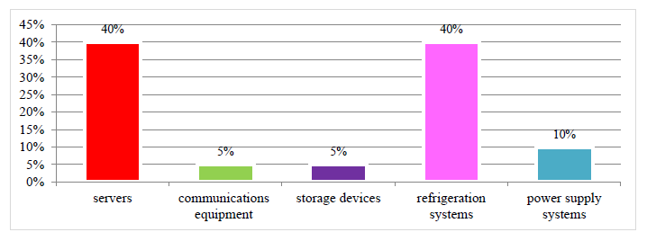
Background (Continued)
According to Nasri, rack servers are major energy misspending factors. Servers that consume less energy are important for continuous evolution of the data centers. There is a linear relation between CPU utilization and power consumption in the server. Servers are the most energy consuming factor. Controlling the temperature is very important. Almost as much as 40% of electricity is consumed via data centers and its devices.

Slide 7
Background – Sources
Fire is a combination of four elements - heat, fuel, oxygen and a chain reaction process - combustion. Fires in data center are different when compared to typical house fires. Most often these are electrical fires. According to Zhang, in data center a variety of materials can be considered as combustibles.
Electronics - routers, power switches, servers, power supplies, batteries and wire insulation.
Structure Materials - cabinets, cabling, material of floors and ceiling and backboards.
Furnishing and Storage - documents, desks, chairs, cardboard boxes and other items.

Slide 8
Background – Sources (Continued)
Sources of heat are-
Power Density - powerful servers packed in smaller spaces increases temperatures to higher levels, too high levels will act as a dangerous heat source. Amazon web services use AI and ML to reduce workload, which reduces temperature.
Warm section containment - encapsulating warm exhausting air from server fans ensures cooler temperatures, else it would rise to dangerous levels.
In most data centers there is ample supply of oxygen present. Fires will keep on raging till all the oxygen is used up. Combustion of electrical equipment produces chain chemical reactions that produce different gases. Corrosive ones like hydrogen cyanide (HCN) and hydrogen chloride (HCL) are very common. All information above are according to Zhang.

Slide 9
Background – Causes
The causes and details are given below.
Electrical failures - Components overheat or short circuit and it results in a raging blaze. Two types - Electrical Surges - When components a sudden burst of high voltage increases which leads to circuit overload. Arc Flashes - electrical leaks due to low impedance connections within systems. Can cause sparks which can cause a fire outbreak.
Lithium-ion Batteries - Are positioned near servers to provide uninterruptible power. In some data centers, separate storage facilities exist just to house the batteries. If exposed to air via leaks or become too hot due to temperatures, catching fire is the only result. Fire from this source spreads quickly.
Improper Maintenance - Often times, simple inadequate maintenance can cause fires. Dust is conductive and can cause static electricity build up and cause fires due to electrical surges.
Human error - Many conditions, can come from simple human errors, like handling dangerous objects without care, improper connections or ignoring safety codes.

Slide 10
Fire detection –
To ensure such disasters do not become uncontrollable many data centers often have various fire detection systems. According to Zheng, prompt identification of fires and responding with countermeasures as soon as possible.
Smoke detectors - photoelectric spot-types and ionization types are popular due to being affordable, reliable with sensitivity regulation. Not good in detecting electrical fires within components.
Heat detectors - good in areas where smoke detection is not practical. Good in areas with dusty or cooler environments.
Air sampling systems - Drawing in air, analyzing combustion particles continuously, can provide early warnings. One of three is often utilized - standard fire detection (SFD), early warning fire detection (EWFD), and very early warning fire detection (VEWFD).
Video detection - video analysis can see earliest fire signs, visible by smoke or fire colors. Can enhance detection via object detection algorithms.

Slide 11
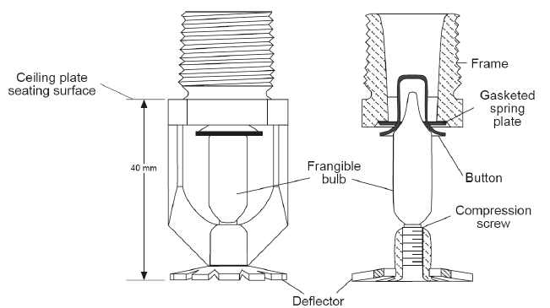
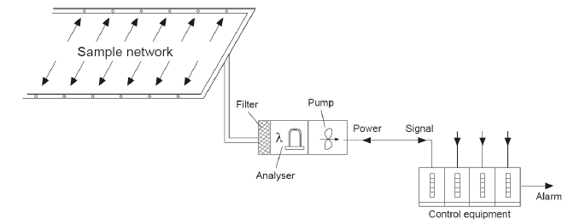
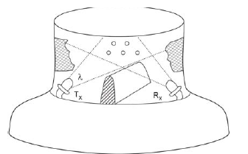
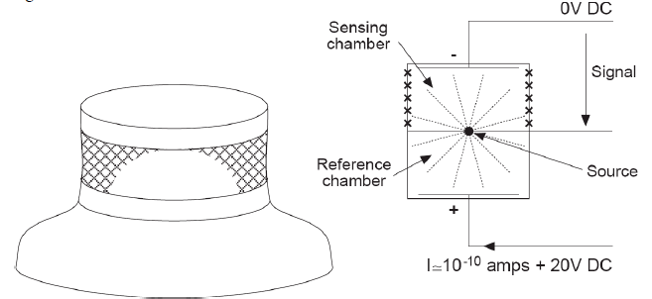
Smoke Detection Diagrams
Sprinkler Hose
Aspirating
Photoelectric
Ionisation Chamber

Slide 12
Fire suppression –
Many dataset centers have various fire suppression systems built within.
According to Novozhilov, computational fluid dynamics are give much attention for prediction of sprinkler spray dynamics. Sprinkler systems and Water-mist systems are common place.
According to Kim, other types of fire suppressing agents have been utilized for a long time. Firstly, halogens were utilized in the 1940’s, though halogens were amazing suppressants, halogens led to ozone layer depletion. Secondly, other
gaseous systems came to function. These systems are of two types halo-carbon agent based, exposure to halo-carbons by humans can cause cardiac arrhythmia. compressed air foam has often been utilized to douse flames. Compressed air foam is formed by injecting pressured air into foam solution and mix is later released in a high pressure from the nozzle.

Slide 13

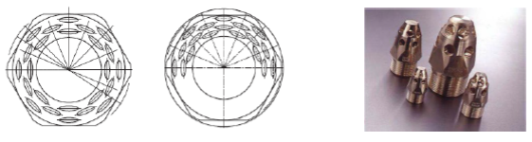
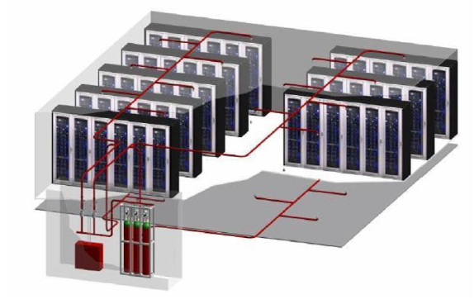
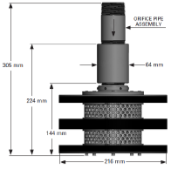
Fire suppression (continued) –
According to Mihalache, Bigan, Panduru and Tsakiris, smoke can damage electronic tools seriously, thus INERGEN gas systems are extremely effective is extinguishing fires in data centers. INERGEN gas composition, system and nozzles given below.

Slide 14
The Dataset
About 517 entries are present with 9 attributes.
The following attributes are present –
X - coordinate of the data rack
Y - coordinate of the data rack
Months - denoting on which month
Days – day the event occurred
Rack temperature - the temperature of the server racks at the given coordinates
Moisture of the rack surroundings
ISI - Initial Spread Index, how much fire spreads from rack
room temperature
Humidity
Data set is pre-processed and fed into the given machine learning algorithm.

Slide 15
Machine Learning approach –
Here, a machine learning based approach is utilized for finding fires, breaking out from server racks. The data set, after pre-processing, is passed through the algorithms of K Nearest Neighbor - KNN, Support Vector Machine – SVM and Random Forest Classifier - RFC.
K-Nearest Neighbor - KNN: According to Srivastava, a popular machine learning technique, that handles regression and classification problems. In training, stores entire data set as a reference.
Support Vector Machine - SVM: As per Gandhi, objective of support vector machine is to find hyperplane in a Z-dimension space where Z denotes number of features, which classifies the data. The algorithm finds the plane which has maximum margin between both data. Support vectors are points closer to the hyperplane.
Random Forest Classifier - RFC: According to Chaudhary, it uses supervised learning methods. Can be applied to classification and regression. Picks data points at random from the training set, creates decision trees for chosen points.

Slide 16
Why change to Machine Learning instead of graph?
A graph based method have too many limitations and results that will be produced will be less accurate and improper.
As such to avoid these issues a machine learning based approach is utilized.
Also graph based methods will not work with arbitrary or different data. Outliers can have drastic affects on the final result. Machine learning algorithms mitigate this issue as well.

Slide 17
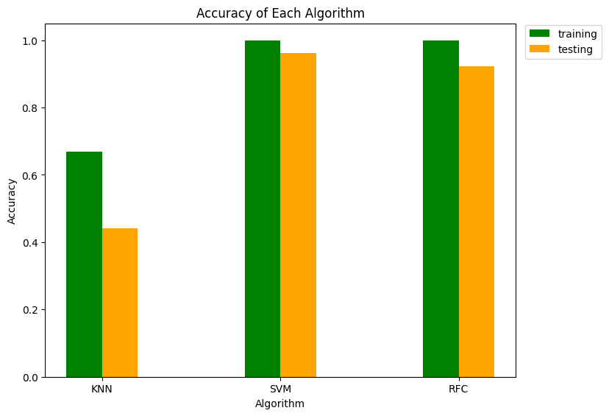

Model simulation and Results.
The data set is pre-processed and then fed into the algorithms. SVM has highest testing accuracy of about 96% followed by RFC which shows 92% testing accuracy. In both case training accuracy is 100% but it is practically close to 98%. KNN has low training accuracy of 67% followed by 44% of testing accuracy. The low accuracy of KNN is due to the randomness of the variables.

Slide 18
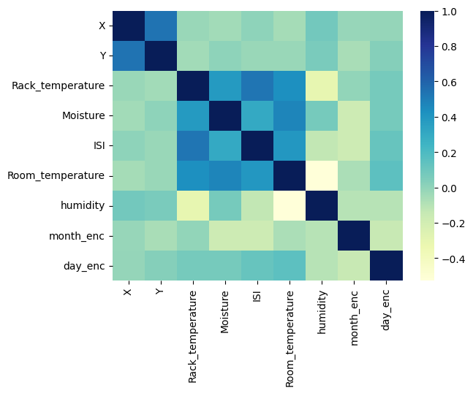
Model simulation and Correlation.
Rack temperature, Moisture, ISI and room temperature have strong correlation, others weak.

Slide 19
Conclusion
Discusses fire modelling and simulation in fire centers. A background study on cloud services is discussed, followed by fire sources and causes. Fire detection is discussed in details and then on fire suppression. A machine learning based approach is utilized to find and suppress fires from breaking out. The dataset and the algorithms used are discussed. KNN, SVM and RFC are utilized and discussed. The model is simulated and results are elaborated. Further research will be done in future.
For future work
The given ML based approach will be further refined to take more variables into account. More advanced algorithms will also be implemented in the design and will be simulated in different scenarios as well. Method will also be tested with fire fighting droids for data centers and on multi-floor data centers in the future.

Slide 20
REFERENCES
1) T. Broughton and D. Laibach, “Four important considerations for data center fire protection,” 2023. [Online]. Available: https://facilityexecutive.com/four-important-considerations-for-data-center-fire-protection/ 2) L. et al., “Exploratory analysis of fire statistical data and prospective study applied to security and protection systems,” international-journal-of-disaster-risk-reduction, vol. 61, p. 102308, 2021. 3) H. A. Rahardjo and M. Prihanton, “The most critical issues and challenges of fire safety for building sustainability in jakarta,” Journal of Building Engineering, vol. 29, p. 101133, 2020. 4) S. T. Ahmed, B. J. Khadhim, and Q. K. Kadhim, “Cloud services and cloud perspectives: A review,” IOP Conference Series: Materials Science and Engineering, vol. 1090, p. 012078, 2021. 5) A. Nasri, “Energy-efficient cloud servers: an overview of solutions and architectures,” The International Journal of Robotics Research, vol. 13, pp. 33–44, 2021. 6) M. Zhang, “Data center fires: A detailed breakdown with 22 examples,” 2023. [Online]. Available: https://dgtlinfra.com/data-center-fires/ 7) M. Spearpoint, “Fire dete ction,” New Zealand Science Teacher, no. 117, pp. 14–16, 2007.
8) V. Novozhilov, “Fire suppression studies,” Thermal Science – THERM SCI, vol. 11, pp. 161–180, 2007.
9) A. Kim, “Overview of recent progress in fire suppression technology,” 2010.
10) C. M. Mihalache, C. Bigan, V. Panduru, and C. Tsakiris, “Modelling of noise reduction for datacentre buildings fire protection with inert gas systems,” MATEC Web of Conferences, vol. 290, p. 12006, 2019.
11) T. Srivastava, “A complete guide to k-nearest neighbors,” 2023. [Online]. Available: https://www.analyticsvidhya.com/blog/2018/03/introduction-k-neighbours-algorithm-clustering/
12) R. Gandhi, “Support vector machine — introduction to machine learning algorithms,” 2018. [Online]. Available: https://towardsdatascience.com/support-vector-machine-introduction-to-machine-learning-algorithms-934a444fca47
13) M. Chaudhary, “Random forest algorithm - how it works & why it’s so effective,” 2020. [Online]. Available: https://www.turing.com/kb/random-forest-algorithm

Slide 21
Thank You
Any Questions?

